Slide 1

POLYTECHNIC OF TURIN
Master’s Degree in Mechanical Engineering
Design of a tubular frame made of natural fiber reinforced composite with epoxy matrix for the cycling industry
Master’s Dissertation
Candidate: Lucrezia Pasi, s288698
Supervisor: Prof. Cristiana Delprete
Co-supervisor: Prof. Chiara Gastaldi
Academic Year 2021-22, 19 October 2022

Slide 2

Aim and contents
Design
Design of a bicycle frame made of composite material on Solidworks.
Model
Model the component and its behavior on Hypermesh.
Compare
Make a comparison between with natural fiber reinforced composite compared to carbon fiber frame.
Trade-off
Find a trade-off between sustainability and performance.
Lucrezia Pasi
s288698
19 October 2022 Design of a tubular frame made of natural fiber reinforced composite with epoxy matrix
for the cycling industry

Slide 3
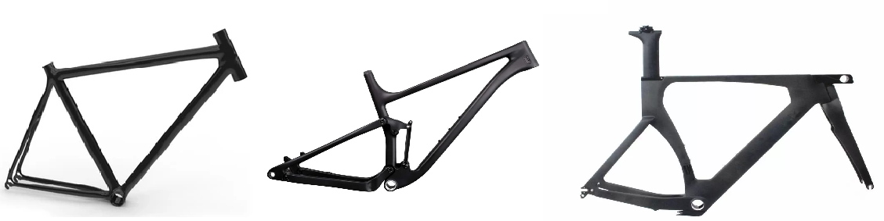
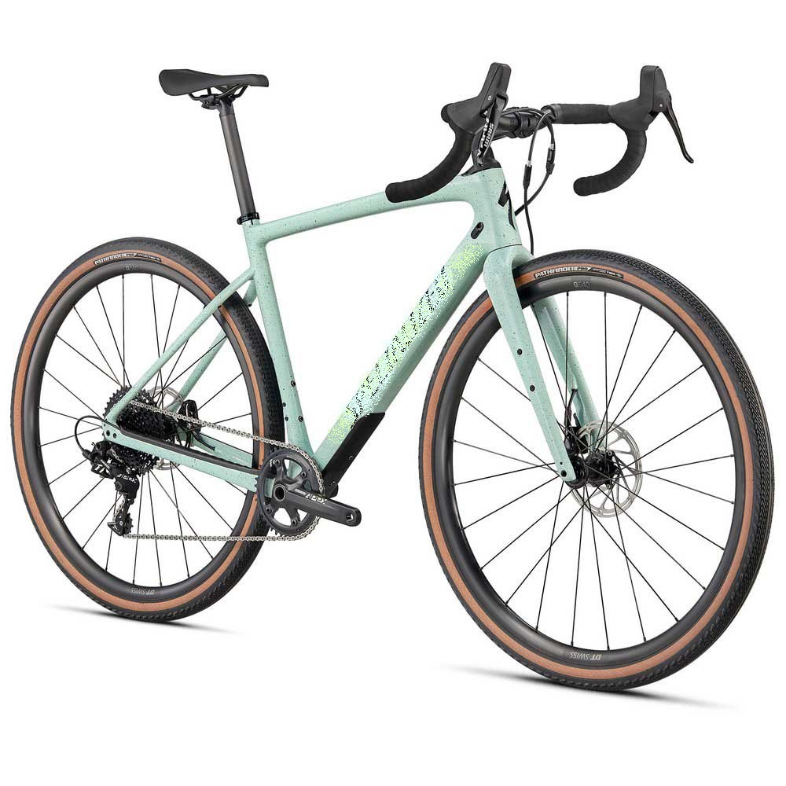
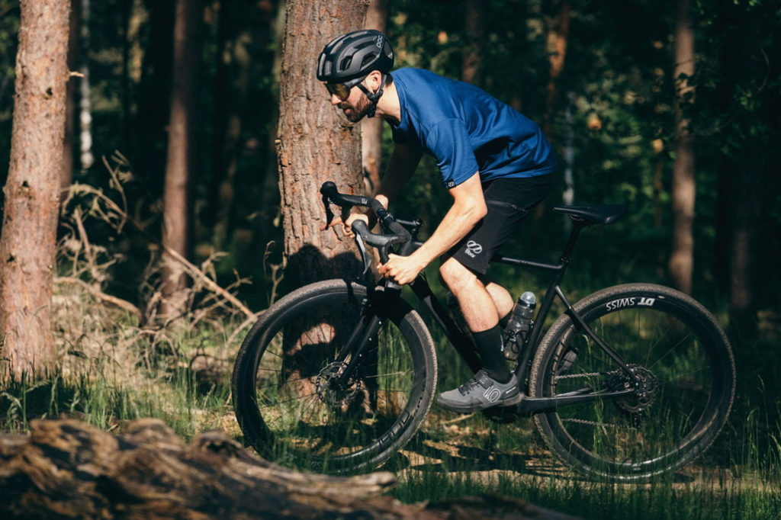
A bicycle frame
Which bicycle and which frame?
A gravel bike
Lucrezia Pasi
s288698
19 October 2022 Design of a tubular frame made of natural fiber reinforced composite with epoxy matrix
for the cycling industry

Slide 4
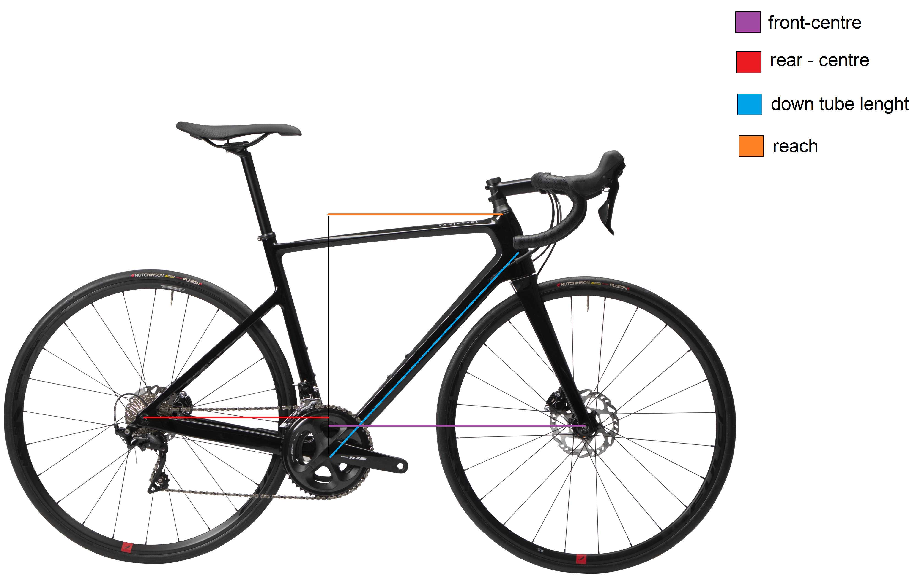
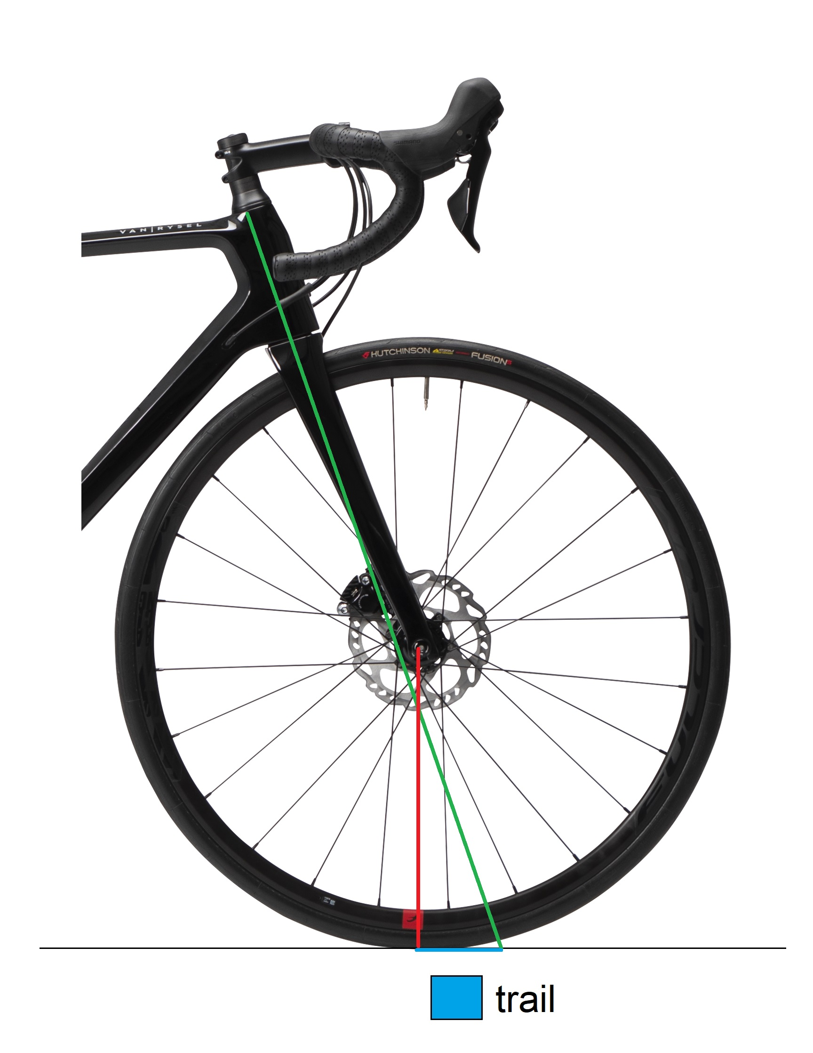
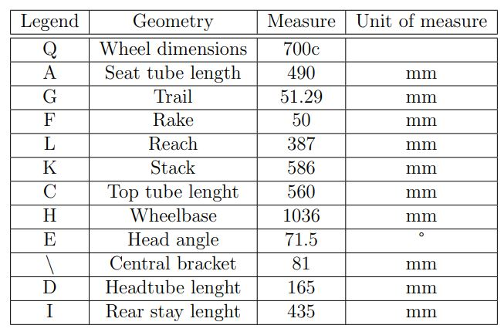
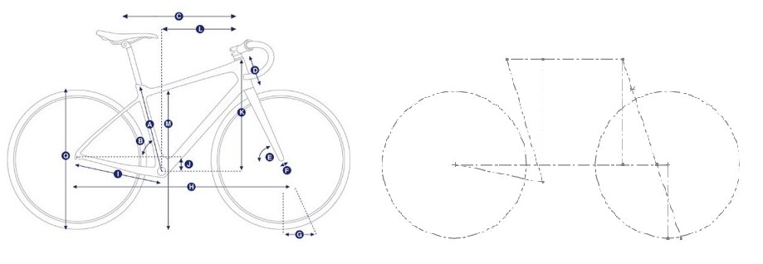
Geometry
Lucrezia Pasi
s288698
19 October 2022 Design of a tubular frame made of natural fiber reinforced composite with epoxy matrix
for the cycling industry

Slide 5
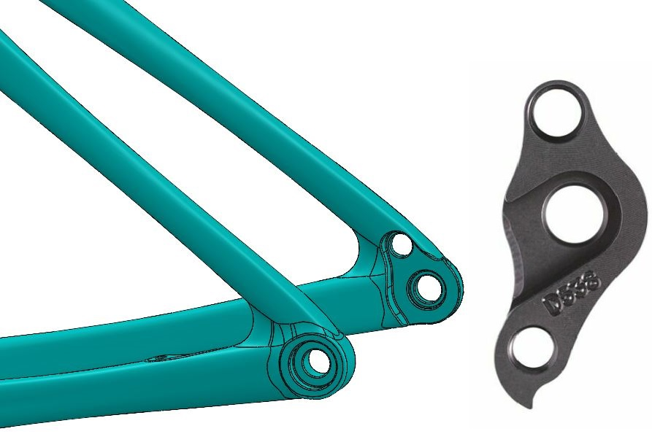
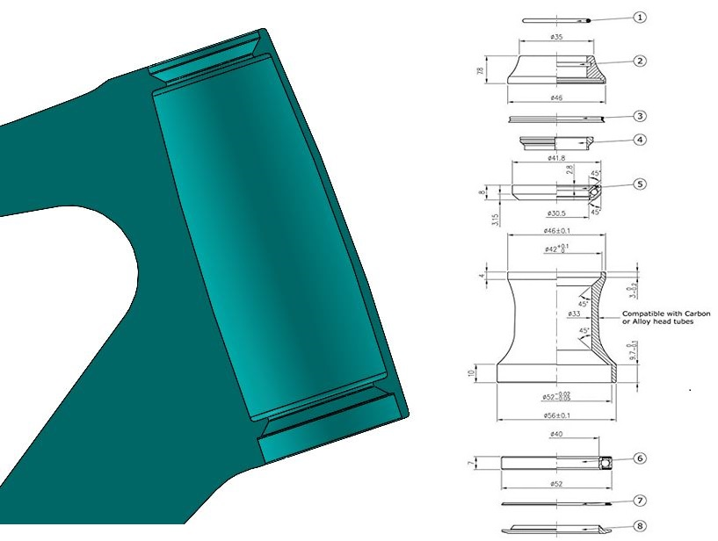
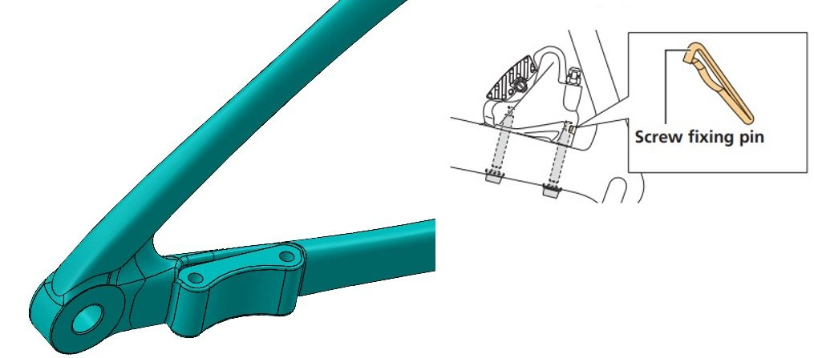
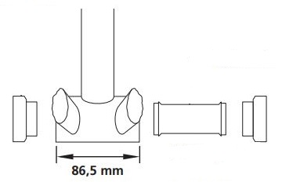
Components
The rear dropout
The head-set
The brake-support
The bottom bracket
Lucrezia Pasi
s288698
19 October 2022 Design of a tubular frame made of natural fiber reinforced composite with epoxy matrix
for the cycling industry

Slide 6
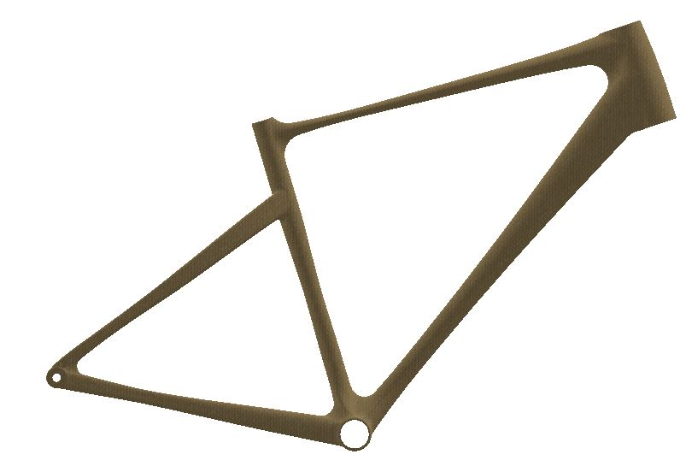
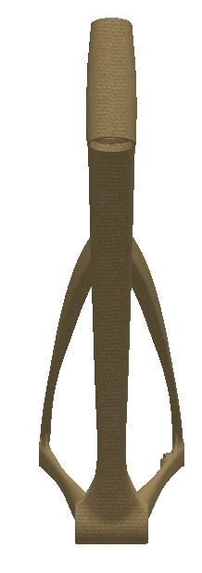
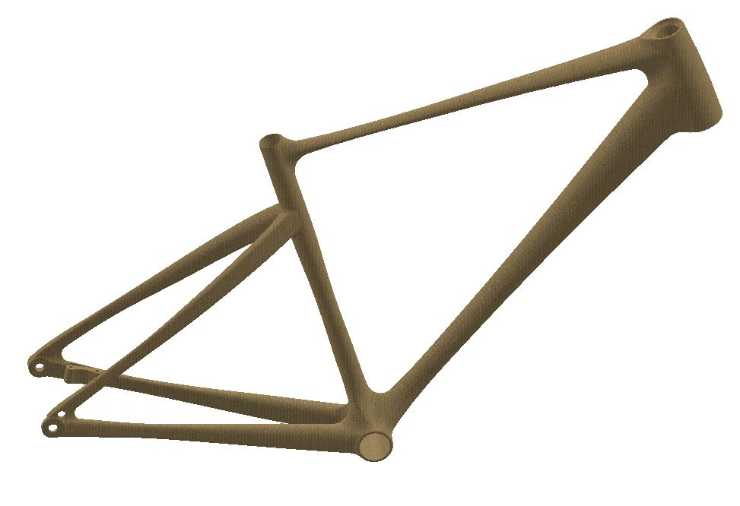
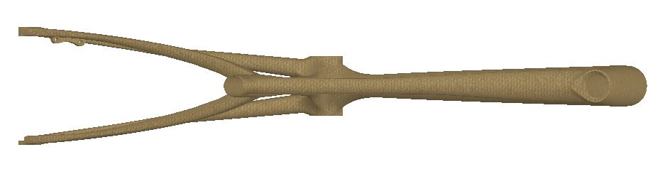
Design result
Lucrezia Pasi
s288698
19 October 2022 Design of a tubular frame made of natural fiber reinforced composite with epoxy matrix
for the cycling industry

Slide 7
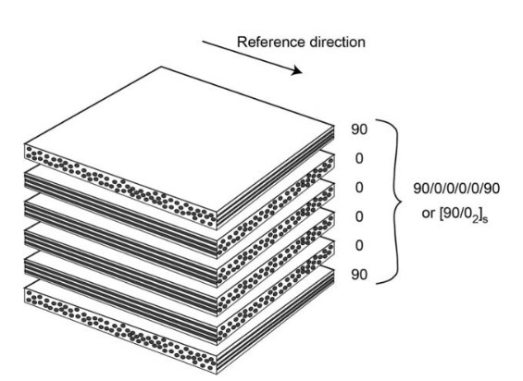
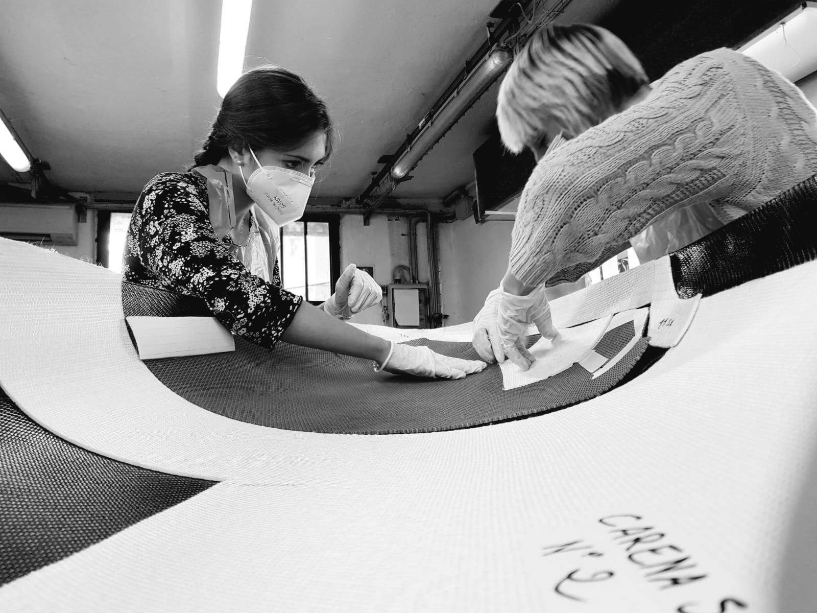
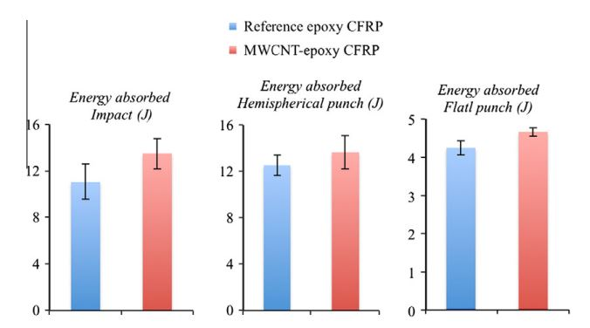
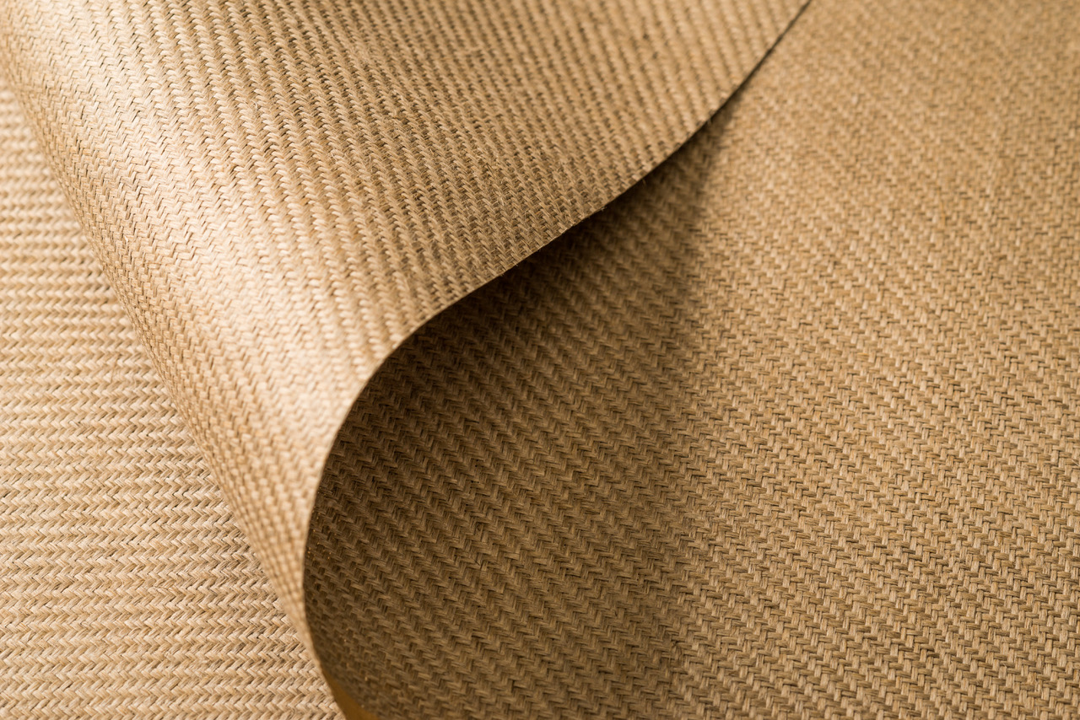
Materials and innovation
Composite materials
Carbon fiber reinforced composites → Nanotube additivated
Natural fiber reinforced composites → Hemp
Lucrezia Pasi
s288698
19 October 2022 Design of a tubular frame made of natural fiber reinforced composite with epoxy matrix
for the cycling industry

Slide 8
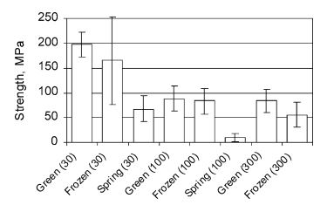
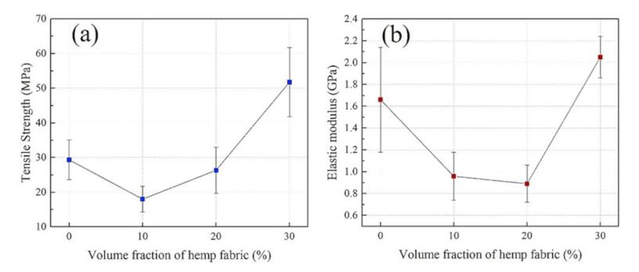
Hemp fiber
One of the strongest and stiffest in between natural fibers
Properties strongly depend on the harvesting and cultivation method
→ Increasing therefore hemp fibers content to 20-30 vol% can improve energy absorption amount
Lucrezia Pasi
s288698
19 October 2022 Design of a tubular frame made of natural fiber reinforced composite with epoxy matrix
for the cycling industry

Slide 9
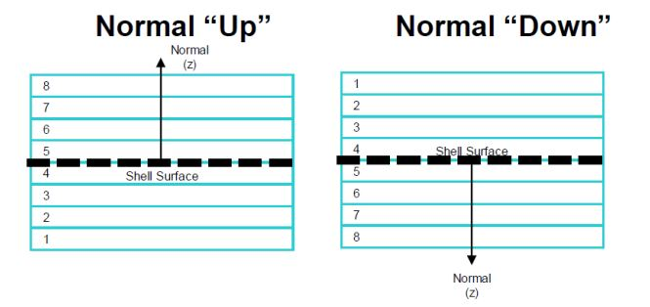
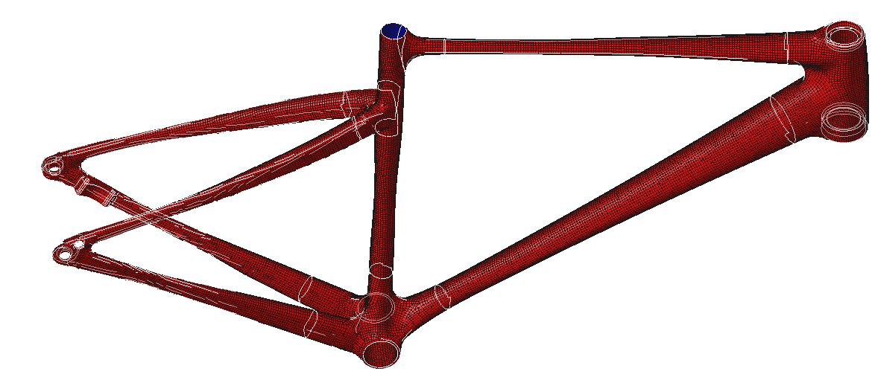
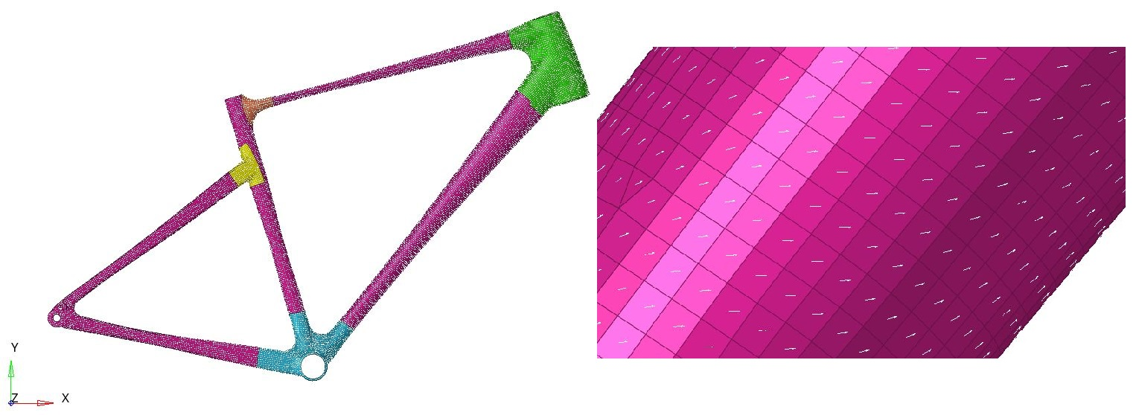
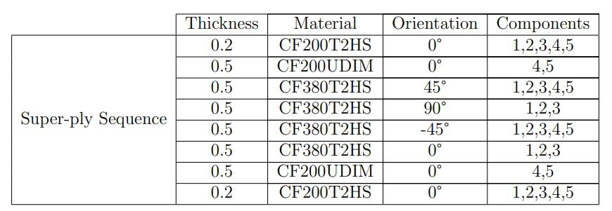
Setting the materials on Hypermesh
Check element’s normal
Set element’s orientation
Create laminate (at first, super-plies)
Lucrezia Pasi
s288698
19 October 2022 Design of a tubular frame made of natural fiber reinforced composite with epoxy matrix
for the cycling industry

Slide 10
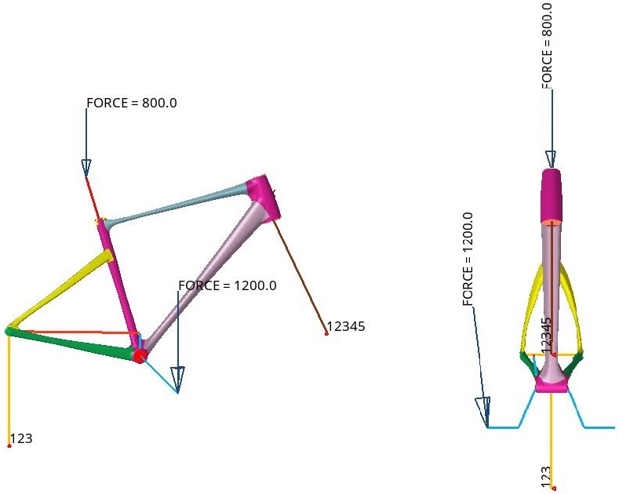
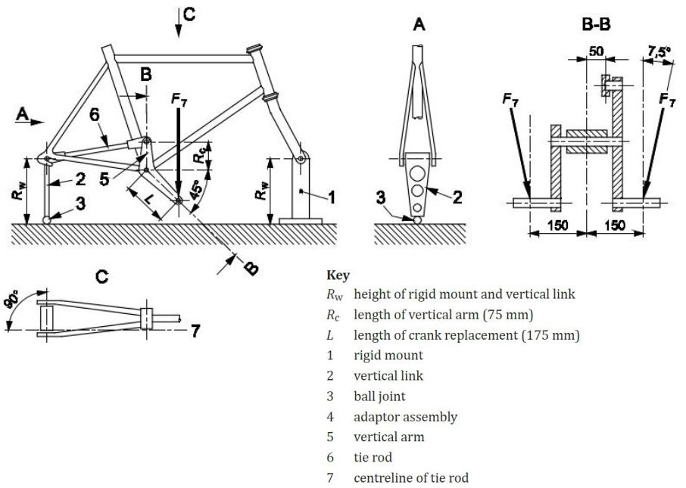
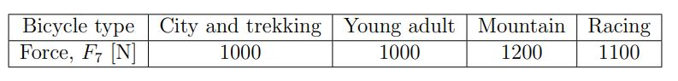
Building a model from standards – pedalling fatigue
Lucrezia Pasi
s288698
19 October 2022 Design of a tubular frame made of natural fiber reinforced composite with epoxy matrix
for the cycling industry

Slide 11
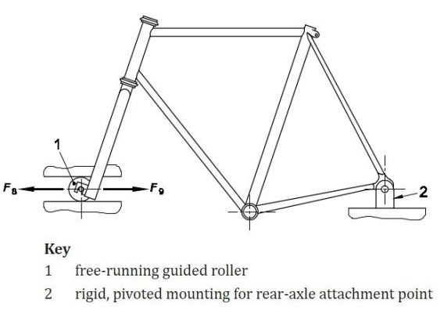
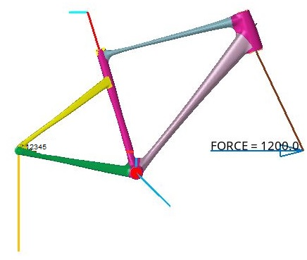
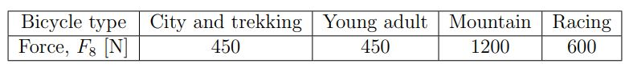
Building a model from standards – horizontal fatigue
Lucrezia Pasi
s288698
19 October 2022 Design of a tubular frame made of natural fiber reinforced composite with epoxy matrix
for the cycling industry

Slide 12
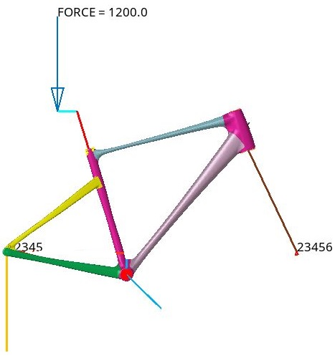
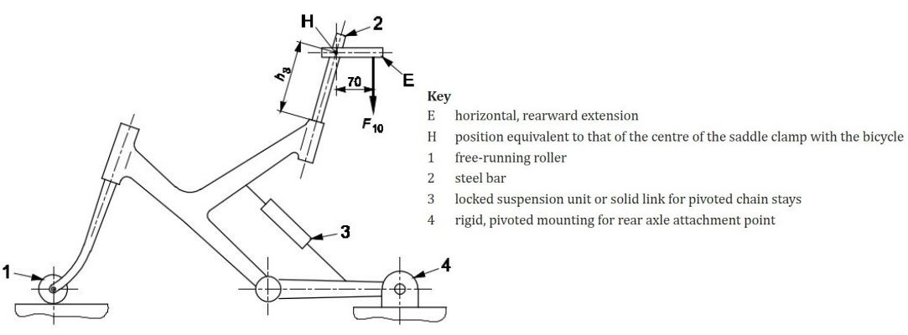
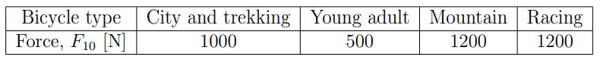
Building a model from standards – vertical fatigue
Lucrezia Pasi
s288698
19 October 2022 Design of a tubular frame made of natural fiber reinforced composite with epoxy matrix
for the cycling industry

Slide 13
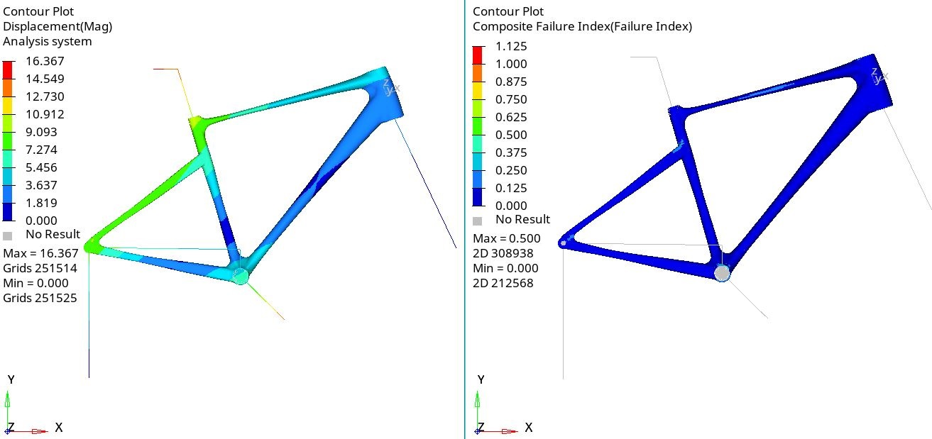
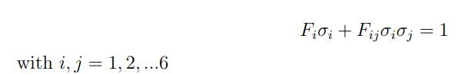
Structural analysis – carbon fiber
FAILURE THEORY based on Tsai – Wu failure criterion
Lucrezia Pasi
s288698
19 October 2022 Design of a tubular frame made of natural fiber reinforced composite with epoxy matrix
for the cycling industry

Slide 14
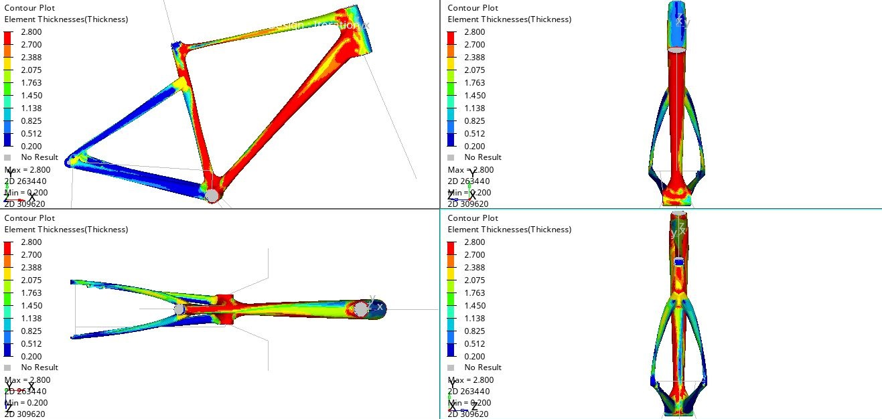
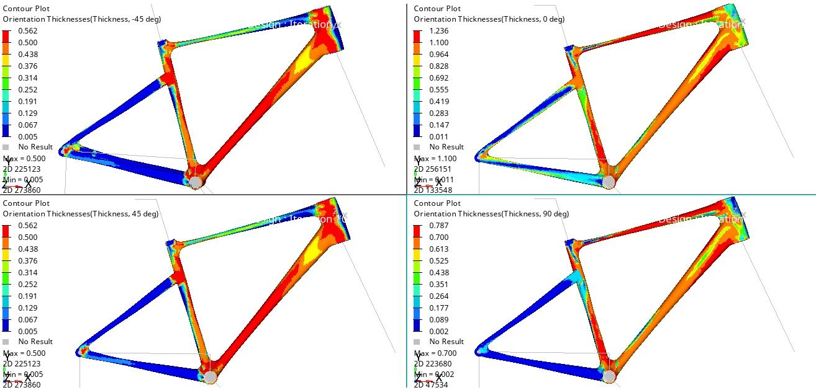
Optimization on Hypermesh – free-size
Lucrezia Pasi
s288698
19 October 2022 Design of a tubular frame made of natural fiber reinforced composite with epoxy matrix
for the cycling industry

Slide 15
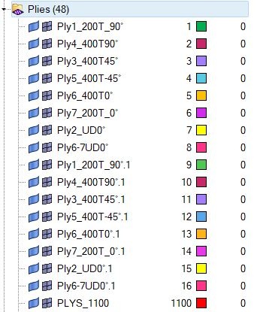
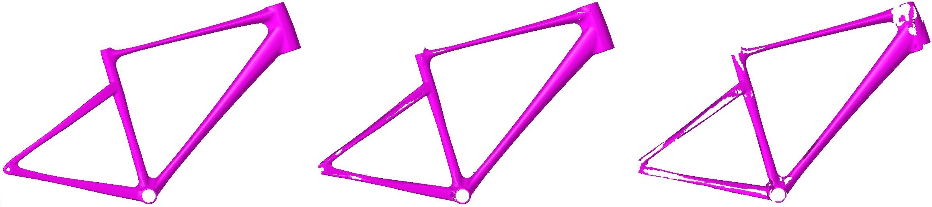
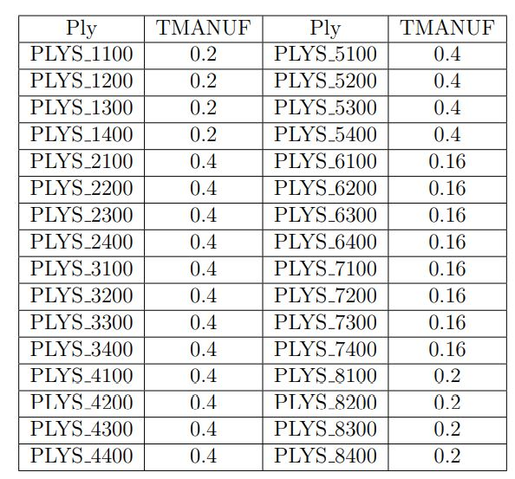
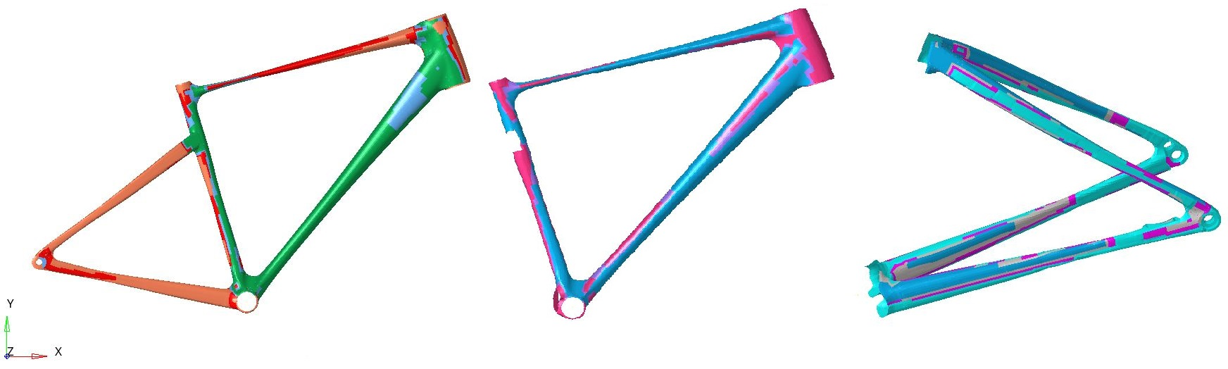
Optimization on Hypermesh – to size
Lucrezia Pasi
s288698
19 October 2022 Design of a tubular frame made of natural fiber reinforced composite with epoxy matrix
for the cycling industry

Slide 16
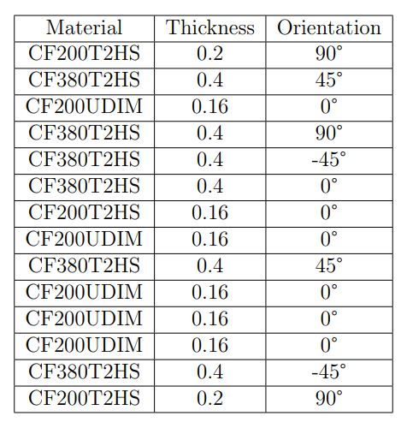
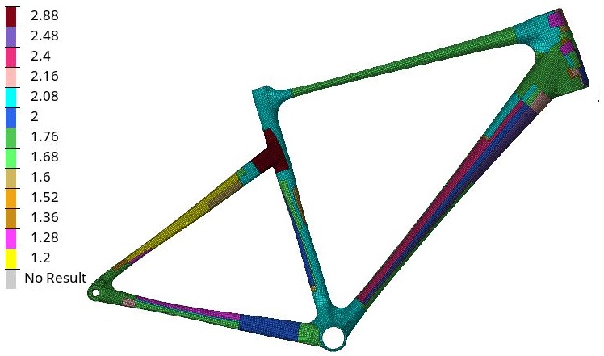
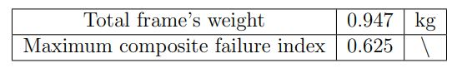
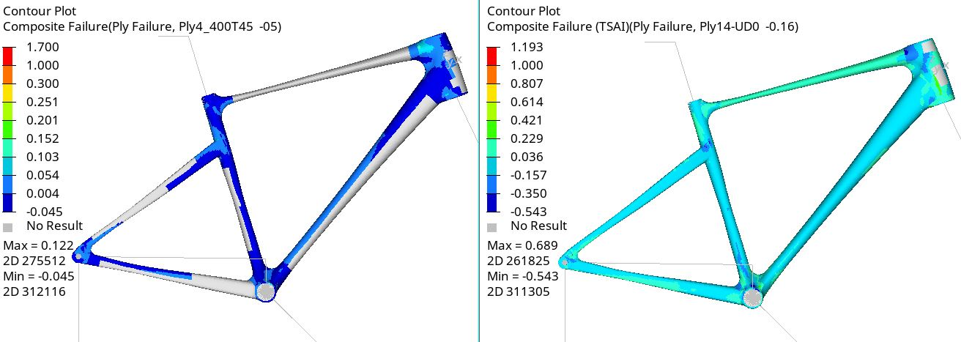
Thickness results – carbon fiber
Lucrezia Pasi
s288698
19 October 2022 Design of a tubular frame made of natural fiber reinforced composite with epoxy matrix
for the cycling industry

Slide 17
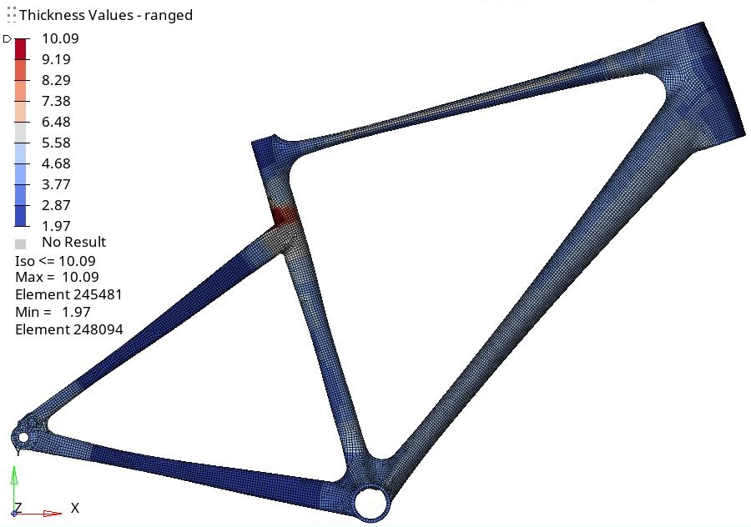
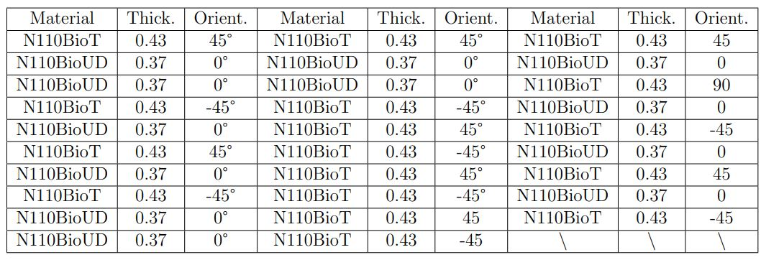
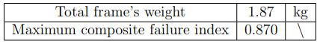
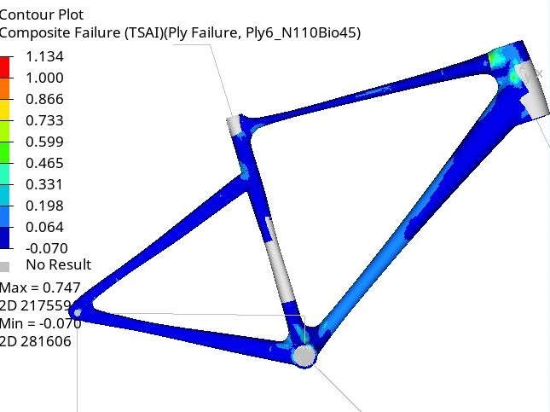

Thickness results – hemp fiber
Lucrezia Pasi
s288698
19 October 2022 Design of a tubular frame made of natural fiber reinforced composite with epoxy matrix
for the cycling industry

Slide 18

Conclusions
Lucrezia Pasi
s288698
19 October 2022 Design of a tubular frame made of natural fiber reinforced composite with epoxy matrix
for the cycling industry

Slide 19
Thank you for your attention
Lucrezia Pasi
s288698
19 October 2022 Design of a tubular frame made of natural fiber reinforced composite with epoxy matrix
for the cycling industry

